Slide 1
Dreamweaver Domain 2: Planning Site Design and Page Layout
Adobe Creative Suite 5
ACA Certification Preparation:
Featuring Dreamweaver, Flash, and Photoshop
1
1

Slide 2
Objectives
Identify best practices for designing a website.
Produce website designs that work equally well regardless of operating system or web browser.
Demonstrate knowledge of page layout design concepts and principles.
Identify basic principles of website usability, readability, and accessibility.
2
2

Slide 3
Objectives (continued)
Demonstrate knowledge of flowcharts, storyboards, and wireframes to create web pages and a site map that maintains the planned website hierarchy.
Communicate with others about design and content plans.

Slide 4
Vocabulary
Cascading Style Sheets (CSS)
deprecated
div element
fixed layout
flowchart
horizontal rule
library object
liquid layout
scope creep
storyboard
styles
template
4
4

Slide 5
Domain 2.0 Planning Site Design and Page Layout
This domain focuses on planning site design and page layout.
5
5

Slide 6
Objective 2.1 Identify Best Practices for Designing a Website
Demonstrate Consistency
Your website demonstrates consistency by using the same layout on all pages.
You can achieve a consistent layout by placing navigation buttons or menus in the same place.
You can demonstrate consistency by using the same colors and fonts on every page.
6
6

Slide 7
Objective 2.1 Identify Best Practices for Designing a Website (continued)
Useful Techniques to Maintain Consistency
Some of the techniques you can commonly use to maintain consistency in a website include using templates and Cascading Style Sheets (CSS), which are also known as styles.
Reusing assets such as library objects can also achieve a consistent look.
7
7

Slide 8
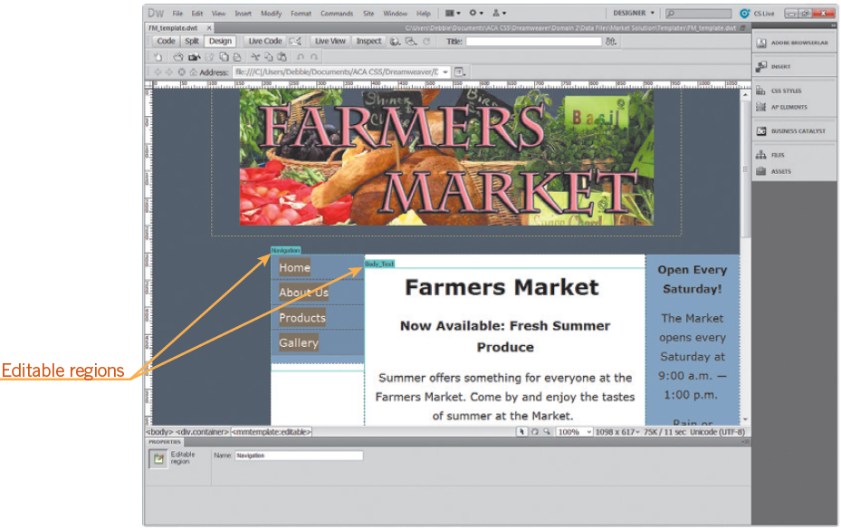
Objective 2.1 Identify Best Practices for Designing a Website (continued)
Useful Techniques to Maintain Consistency (continued)
A template is a master page that you create and then reuse to maintain a consistent layout or style.
8
8

Slide 9
Objective 2.1 Identify Best Practices for Designing a Website (continued)
Useful Techniques to Maintain Consistency (continued)
Library objects are reusable assets that are maintained in the Assets panel in the Library category. You can use them with templates or in the place of a template.
Identify the Benefits of Consistency
A consistent design between pages of a website improves the usability and accessibility for the user.
9
9

Slide 10
Objective 2.1 Identify Best Practices for Designing a Website (continued)
Identify the Benefits of CSS Style
Cascading Style Sheets make it easier to maintain a website, they are more accessible to every browser, and they help your page download faster because the style sheet is stored in the browser’s cache.
When Cascading Style Sheets are shared between pages in a website, any changes you make to an applied style is automatically updated in any page in which that style is applied.
10
10

Slide 11
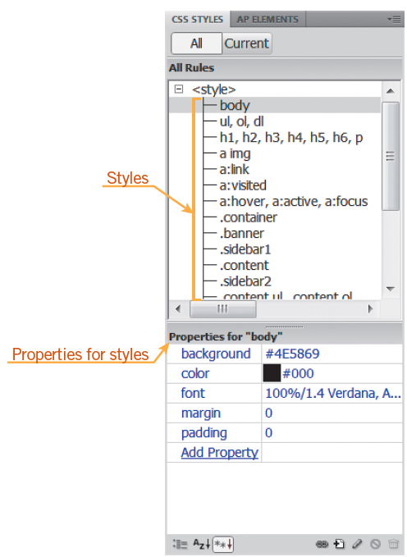
Objective 2.1 Identify Best Practices for Designing a Website (continued)
Identify the Benefits of CSS Style (continued)
The CSS specifications are overseen by the World Wide Web Consortium (W3C).
Dreamweaver CS5 requires the use of CSS styles when creating a new or custom style for text. You can manage CSS with the CSS Styles panel.
11
11

Slide 12
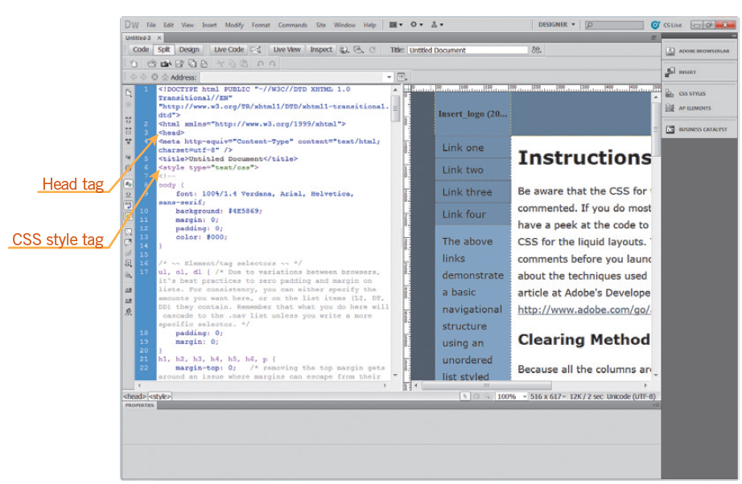
Objective 2.1 Identify Best Practices for Designing a Website (continued)
CSS Best Practices
CSS layouts or starter pages are available when beginning a new document under the HTML category.
12
12

Slide 13
Objective 2.1 Identify Best Practices for Designing a Website (continued)
Identify Features Used to Maintain Page Structure
Features in a website that you can use to maintain page structure may include the following items:
Headings
Use of font styles and sizes
Color Schemes
Size and placement of photos
Use of design elements such as bullets
Use of indentation to organize content
13
13

Slide 14
Objective 2.1 Identify Best Practices for Designing a Website (continued)
Demonstrate Knowledge of Fixed and Flexible Page Sizing
Dreamweaver provides optional starter pages that set either fixed or flexible page sizing.
A fixed layout sets values in pixels for any columns and the overall width and is centered in the browser window.
A liquid layout sets the values using percentages for any columns and the overall width, and the percentage is determined by the user’s browser window.
14
14

Slide 15
Objective 2.1 Identify Best Practices for Designing a Website (continued)
Demonstrate Knowledge of Fixed and Flexible Page Sizing (continued)
Tables are another way to control the placement of text and images from one browser to another.
The length of a text line or whether or not text wraps may be controlled with tables.
Dreamweaver also provides the option to verify different monitor sizes by using the status bar in the Dreamweaver document window.
15
15

Slide 16
Objective 2.1 Identify Best Practices for Designing a Website (continued)
Demonstrate Knowledge of What Affects Printing a Web Page
You can create a separate CSS to handle how a web page will print.
You can change the font used for printing to make the printed document more readable.
You may also choose to eliminate some of the content from the printed page, such as navigation elements and other advertisements.
16
16

Slide 17
Objective 2.2 Produce Website Designs that Work Equally Well Regardless of Operating System or Web Browser
Identify Website Elements that May Display Differently
A variety of operating systems and web browsers are available for those using the Internet.
Some fonts are not available on all operating systems.
Dreamweaver creates a font family that includes a list of related fonts that will work on both the Windows and Mac operating systems.
17
17

Slide 18
Objective 2.2 Produce Website Designs that Work Equally Well Regardless of Operating System or Web Browser (continued)
Identify Website Elements that May Display Differently (continued)
Because web browsers vary by user, it is important during website design to consider how your web page will be displayed.
Browser-safe colors, also known as web-safe colors, are a palette of 216 colors that was developed in the mid-1990s to provide a list of colors that would be displayed the same on all monitors that could display 256 colors or more.
18
18

Slide 19
Objective 2.2 Produce Website Designs that Work Equally Well Regardless of Operating System or Web Browser (continued)
Identify Website Elements that May Display Differently (continued)
The formatting of margins, table borders, and padding may be displayed differently from one browser to another. To avoid these problems, set margins and padding to zero.
A horizontal rule is a line that can be customized on a web page. To ensure that a horizontal rule will be displayed correctly in all browsers, it is important to use CSS rather than HTML.
19
19

Slide 20
Objective 2.2 Produce Website Designs that Work Equally Well Regardless of Operating System or Web Browser (continued)
Demonstrate Knowledge of BrowserLab
BrowserLab is a component of the Adobe CS Live online services and is a subscription-based service.
BrowserLab previews a web page across multiple browsers and operating systems to test the compatibility of your design.
20
20

Slide 21
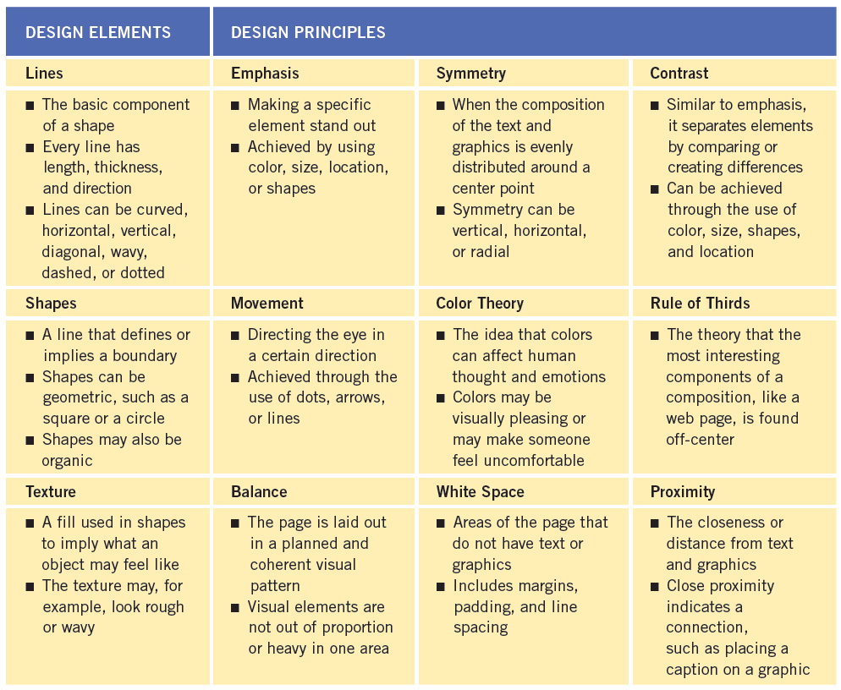
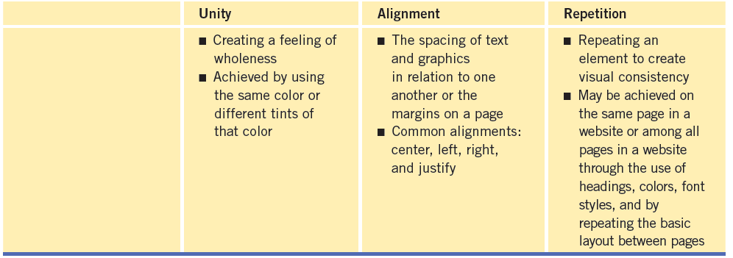
Objective 2.3 Demonstrate Knowledge of Page Layout Design Concepts and Principles
It is important to understand some concepts of graphic design to be able to create an appealing website that will attract people to your site and keep them returning.
21
21

Slide 22
Objective 2.4 Identify Basic Principles of Website Usability, Readability, and Accessibility
Elements Used to Improve Website Usability
Improving website usability is important to encourage visitors to stay at your website once they arrive.
Page loading time
Ease of finding information
Consistent layout throughout the website
Alternative text placed on images
Use of headings
Varying text size and color
Use of tables to organize information
Placement of important information relative to scrolling
22
22

Slide 23
Objective 2.4 Identify Basic Principles of Website Usability, Readability, and Accessibility (continued)
Demonstrate Knowledge of Text-Formatting Guidelines
It is recommended that text be styled with CSS rather than representing text as an image.
It is also essential to specify a generic font in case the user does not have the specific font on his or her computer.
You should also control the formatting and positioning of text with CSS.
Another item that has been deprecated is the use of color names instead of hexadecimal or RGB numbers to indicate color choice.
23
23

Slide 24
Objective 2.4 Identify Basic Principles of Website Usability, Readability, and Accessibility (continued)
Demonstrate Knowledge of Text-Formatting Guidelines (continued)
Tables have commonly been used to control the layout of web pages rather than just the presentation of data.
If you plan to use tables to control the layout of a web page, it is important to test the table to see if it linearizes, or reads the content in the correct order.
You should design tables using proportional sizing rather than absolute sizing. This allows the user to magnify the table either with specialty accessibility software or magnification options available in the browser.
24
24

Slide 25
Objective 2.4 Identify Basic Principles of Website Usability, Readability, and Accessibility (continued)
Identify Specific Techniques to Make a Website Accessible
Alternate text provides a text alternative to nontext content on web pages, such as graphics, buttons, movies, and sound.
When creating an image map with hotspot tools, it is important to provide alternate text that will explain its function and make sense out of context for every hotspot created.
When working with text links, it is possible to add alternate text and create keyboard accessibility to activate the links on your page.
25
25

Slide 26
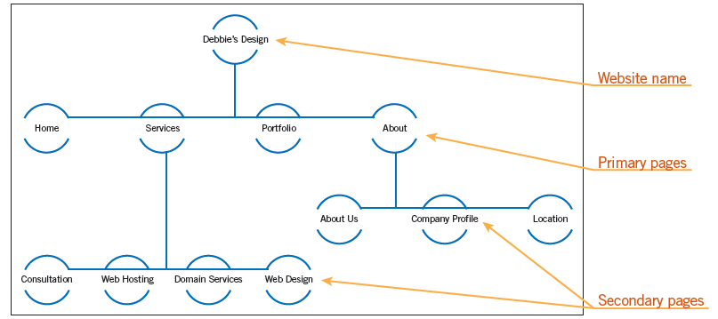
Objective 2.5 Demonstrate Knowledge of Flowcharts, Storyboards, and Wireframes to Create Web Pages and a Site Map (Site Index) that Maintain the Planned Website Hierarchy
When planning a website, the first stage is to create a flowchart. A flowchart is a visual way to outline your website.
26
26

Slide 27
Objective 2.5 Demonstrate Knowledge of Flowcharts, Storyboards, and Wireframes to Create Web Pages and a Site Map (Site Index) that Maintain the Planned Website Hierarchy (continued)
The next stage is to create a wireframe that shows the layout for each page.
The final stage is to create a storyboard.
A storyboard uses the information from the flowchart and the wireframe to provide details for each page in a website, breaking down the plans for the site into manageable pieces.
27
27

Slide 28
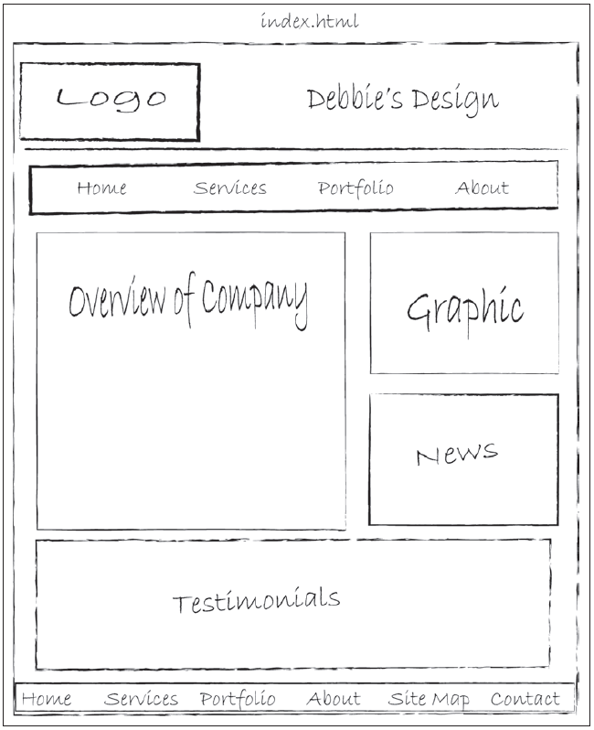
Objective 2.5 Demonstrate Knowledge of Flowcharts, Storyboards, and Wireframes to Create Web Pages and a Site Map (Site Index) that Maintain the Planned Website Hierarchy (continued)
On a storyboard, it is a good idea to show how each page will be organized with the headings, content, links, graphics, and the name of the page.
28
28

Slide 29
Objective 2.6 Communicate with Others About Design and Content Plans
Your project should have a project manager to oversee the communication process and to help keep individuals on task and on time.
It is extremely important to be honest with your team and to work together to meet deadlines.
One problem that arises in the development process is called scope creep. Scope creep refers to changes in the requirements of the project as the project is being constructed.
29
29

Slide 30
Summary
Objective 2.1 Identify Best Practices for Designing a Website
Objective 2.2 Produce Website Designs that Work Equally Well Regardless of Operating System or Web Browser
Objective 2.3 Demonstrate Knowledge of Page Layout Design Concepts and Principles
Objective 2.4 Identify Basic Principles of Website Usability, Readability, and Accessibility
30
30

Slide 31
Summary (continued)
Objective 2.5 Demonstrate Knowledge of Flowcharts, Storyboards, and Wireframes to Create Web Pages and a Site Map (Site Index) that Maintain the Planned Website Hierarchy
Objective 2.6 Communicate with Others about Design and Content Plans
31
31

